Slide 1

Data Science
Exploratory Data Analysis
Of Edsigh Ed-Tech
Uche Onyemali
By Uche Onyemali
Edsigh Ed-Tech

Slide 2

About Us:
EdSigh Ed-Tech is a globally recognized online learning
platform that provides a wide range of courses on a variety of topics.
Since its inception in 2010, EdSigh Ed-Tech has grown to become one of
the world's largest e-learning platforms, serving millions of students
and teachers worldwide.
EdSigh Ed-Tech's primary goal is to make education
accessible and affordable to anyone with an internet connection.
Teachers create and publish their courses on the platform, and
students can enroll based on their interests and learning goals.
EdSigh Ed-Tech offers certifications and training in courses,
such as Business Finance, Graphics Design, Musical Instruments, and
Web Development. EdSigh Ed-Tech 's extensive course catalog ranges
from technology to business, art to personal growth.

Slide 3
Problem Overview
Leveraging the power of their data to gain
insights into the business and improve
their efficiency.
EdSigh Ed-Tech seeks to understand the
performance of each course.

Slide 4
The Goal of the notebook is to:
Explore every feature in the dataset
and uncover where potential
opportunities to increase business
revenue lie; e.g. Explore the
relationship between price and
Num_Subscribers.

Slide 5
Exploratory Data Analysis:
There is no missing data.
Univariate Analysis
Bivariate Analysis
Multivariate Analysis

Slide 6
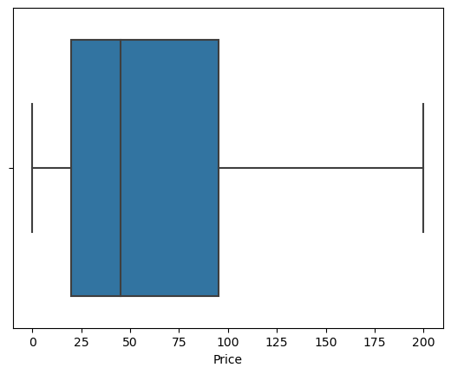
Univariate Analysis
There are no outliers in the
prices of courses
at Edsigh. Concentration of prices range
from 25 to 100 dollars, the minimum price
at 0 and maximum price at
200 dollars.

Slide 7
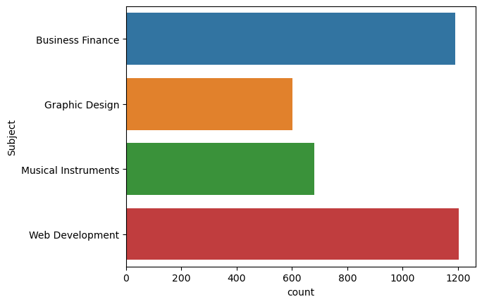
We have 1200 students
enroll for Web Develop
-ment , followed
closely by Business
Finance and Graphics Design had the lowest numbers of close to
600 students.

Slide 8
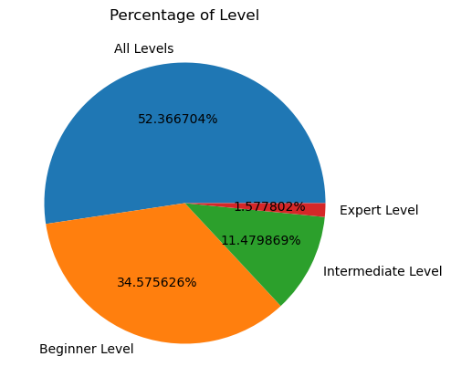
All level has the highest percentage of 52.3%, followed by 34.5% for the Beginner level, the intermediate level is at
11.4% while the lowest percentage is that of the Experts at 1.5%

Slide 9
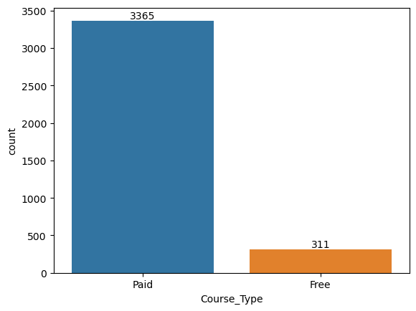
A majority of the course types are paid for totaling 3365 while 311 courses are free. This should be good for the revenue of Edsigh Ed-Tech. I would advise that the free classes are given as some form of rewards either when students bring referrals, so that way its a win-win situation for both parties.

Slide 10
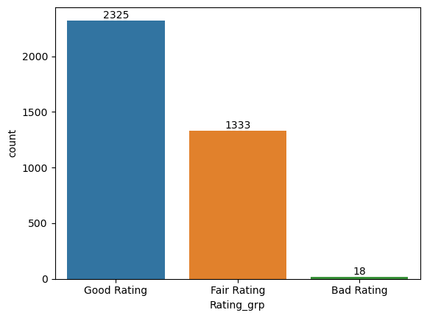
The Rating has been grouped into 3 categories. The Good rating has the highest category of 2325 which is good for Edsigh Ed Tech, then the Fair Rating is next totalling 1333 and just 18 Bad rating from the learners.There should be further enquiry frm the 18 learners on what they want to see improved for a better rating.

Slide 11
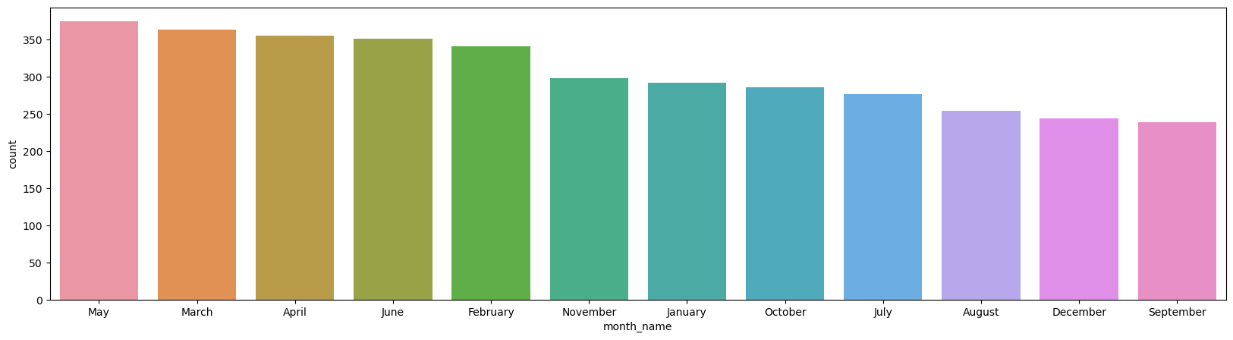
September and December have the lowest counts of learners this could be attributed to new academic session and festive holidays, more online marketing campaigns should be done, and targeted at the right audience. May has the highest count , followed by March and April.

Slide 12
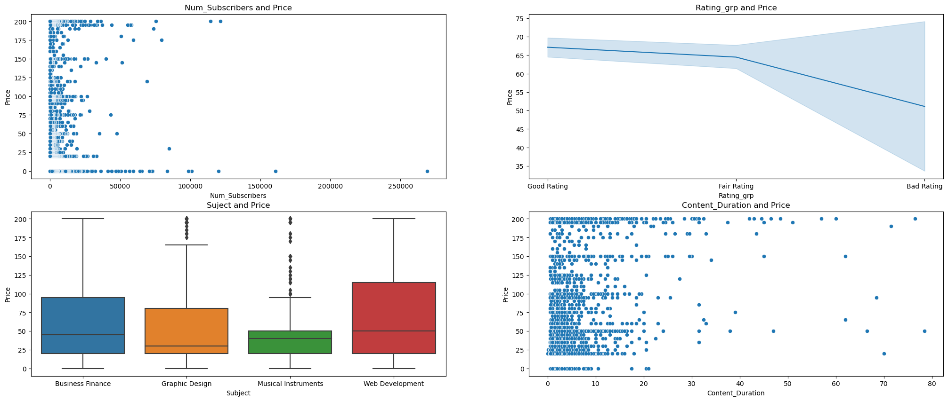
From the 1st graph of Number of subscribers and price, we can denote that majority of its subscriber numbers is btw 0-50,000 , with the highest price 200 dollars having more concentration, with a few outliers in the price 0 which is free. From the 2nd graph, the rating is grouped (Good, Fair and Bad rating) and its relationship with the price. The good and fair rating courses have high prices. while the courses with bad rating have lower prices. Learners are ready to pay even high prices as long as they get value. From the 3rd graph, we clearly see Subjects and the Prices, and it can be clearly concluded that Web Development has the highest prices, followed by Business Finance, next is the Graphics Design and the Musical Instruments has the lowest prices From the 4th graph, the relationship btw the content duration and price. There is more concentration of content duration from 0-20mins for all the various prices available. It can also be noticed a lot of outliers across the graph.

Slide 13
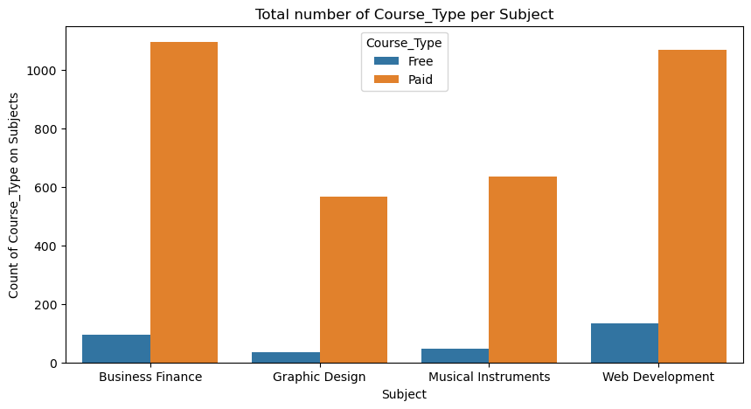
Business Finance is the highest paid subject, followed by Web Development, and Graphic Design is the least paid subject. While the free courses are generally low (100 and less)across all the subjects with web development topping the free course types and graphics design still as the least even for free.

Slide 14
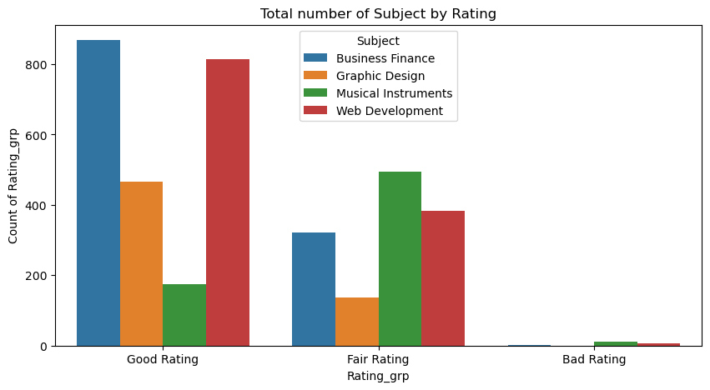
The relationship btw the subjects and their rating groups shows clearly that the Business Finance and Web Development have the highest good ratings. I will recommend Musical Instrument and Graphic Design will need to be revamped, get feedback from the learners to improve both subjects, in terms of getting more paid learners and higher ratings. There were no significant bad ratings.
Rating vs the prices, the least prices from 0-20 seem to have good ratings while the higher and expensive price that would yield more revenue have very low price count. There is really no significant Bad rating in Edsigh Tech which is commendable. More effort has to be on increasing the price counts for the expensive and high priced courses.

Slide 15
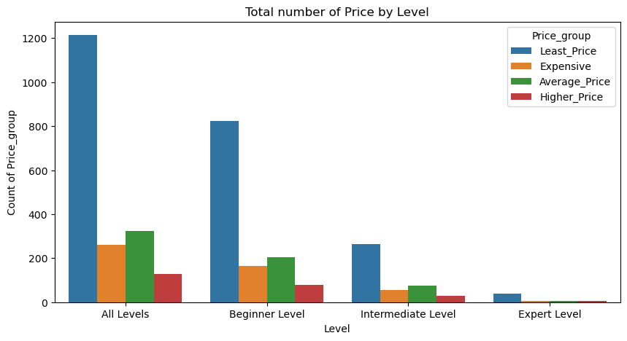
The relationship btw the level and prices, the 3 levels (All levels, beginner level, intermediate level) all have the highest counts for the Price (least price $50 and below). That cannot help to increase revenue generated in Edsigh Ed-Tech. The prices will need to be reviewed especially for the 2 high demand subjects(Business Finance & Web Development). Also it can be noticed that both the Intermediate and Expert level

Slide 16
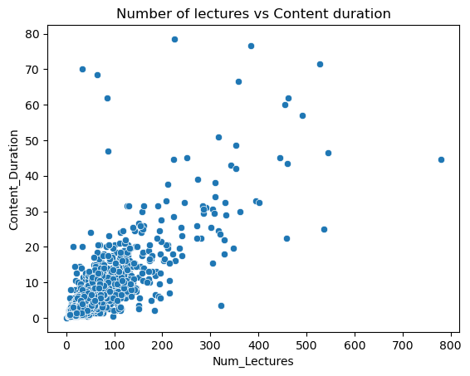
The relationship between the number of lectures and the content duration shows majority of the lectures (0-300) had shorter content duration of 0-50 minutes. It can be said that the learners prefer shorter content duration rather than the lengthy ones.

Slide 17
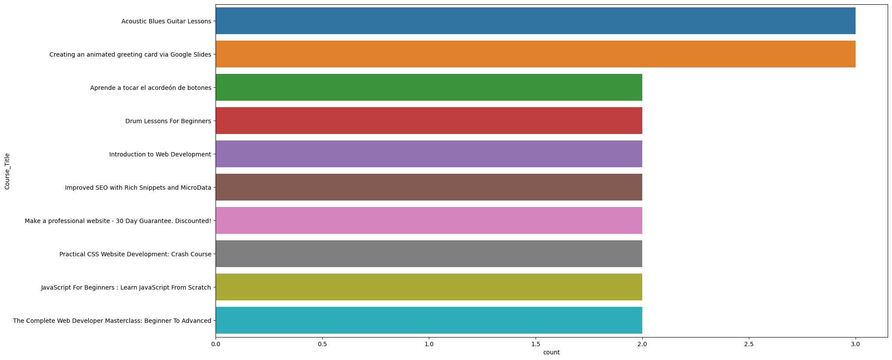
Due to the numerous Course titles, lets focus on the top 10 counts.8 out of the 10 top course titles fall under the Web Development, seems most learners have a preference for Web Development. Though there are 1 course title in Musical Instruments and Graphics Design respectively.

Slide 18
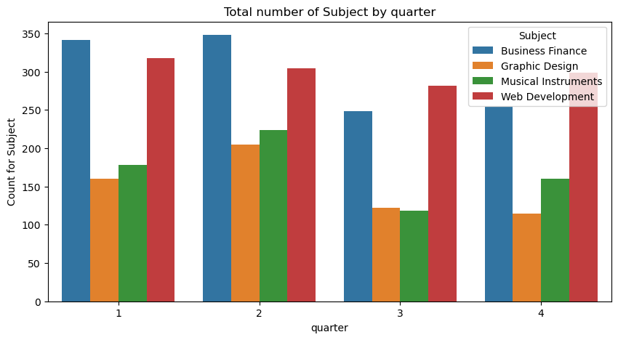
The 1st and 2nd quarter seem
to have had the highest count
of learners with Business
Finance and Web
development respectively.
The 3rd quarter had Graphic
Design and Musical
Instrument having the lowest
counts, followed by the 4th
quarter. More marketing
campaigns would be highly recommended like adverts
on social media, digital
marketing to get more
learners aware of Edsigh Tech.

Slide 19
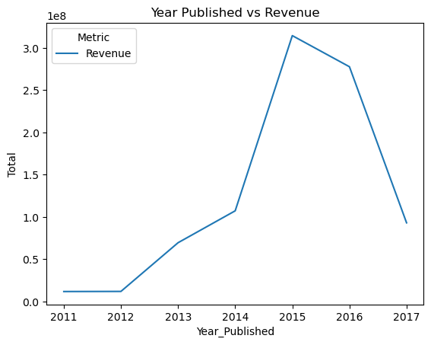
Looking at the revenue
over the years, from 2011
to 2012 the early years of the
business there was a
stagnation of 0.1, and
from 2012-2014 there was a
significant growth from 0.1
to 1.1, from 2014 to 2015
there was a huge spike
in its revenue from 1.1 to
3.0 its all time high, then
in 2015 to 2016 there was
a slight decline from 3,0
to 2.2, and later part of
2016 to 2017 a drastic
decline in their revenue
from bout 2.2 to about 1.0.

Slide 20
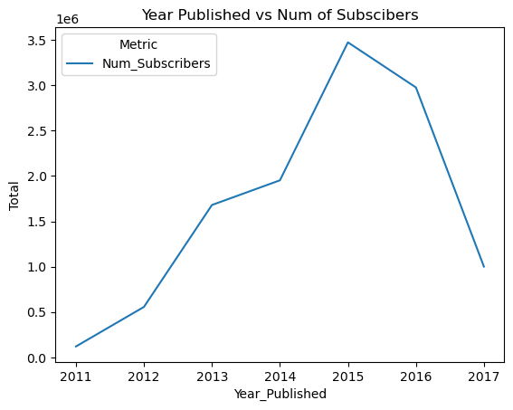
There was an increase
in subscribers from the
1st year 2011-2012,
though it didn’t reflect in
the revenue from 2011 to
2012 there might
have been a lot of free
classes given. The
subscribers kept
increasing from 2012-
2015. The later part of
2015 to 2017 the
subscribers have been
declining.

Slide 21
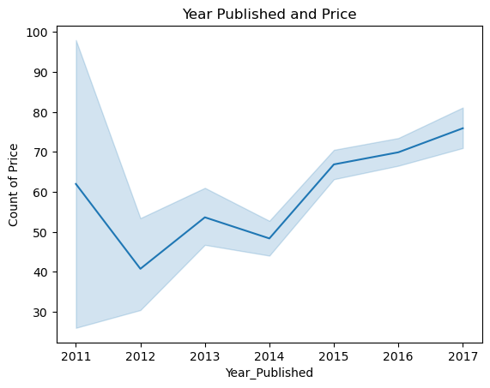
From inception 2011 up till 2012,
the price count dropped to
attract learners since they
were new in the market. In 2012
it went back up to about 55
price count, then came down
from 2013 -2014. It can be
noticed that despite the price
decrease from 2011- 2014 ,the
number of subscribers still
increased. From 2014 -2015,
despite the increase in price
count from 50 to about 65, the
number of subscribers still
increased. Also from 2016 to
2017, with the price count
increase the number of
subscribers declined drastically.

Slide 22
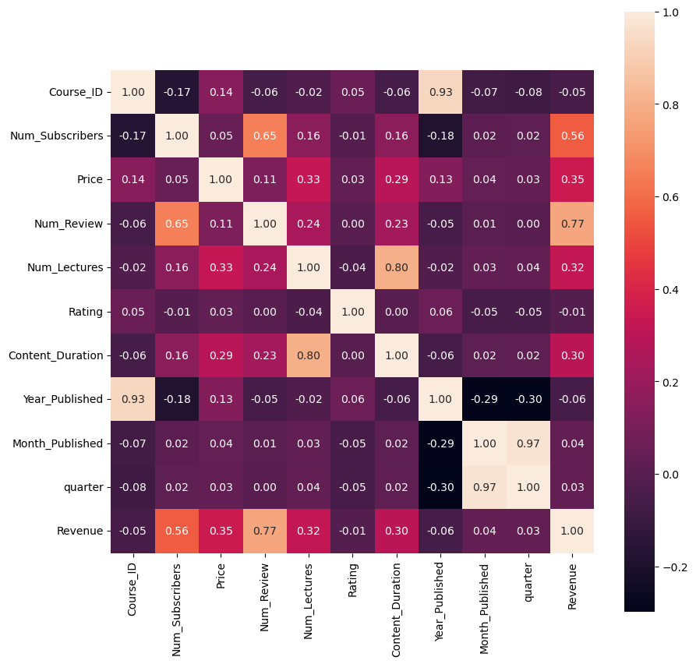
.
The heat map shows both negative and positive
correlations in the various features. The correlation btw
Price and number of
subscribers is at 0.05 which is quite weak. Month Published
and quarter had the
strongest correlation of 0.97,
then Course Id and year
have a correlation of 0.93,
also number of lectures and content duration have a correlation of 0.8.

Slide 23
Recommendation
In leveraging the data to gain insights and improve efficiency in Edsigh Ed-Tech, a few recommendations can be given
Edsigh Ed Tech seems to be known for their tech courses . The Web development subject did better than the others and learners gave a good rating for it, also the learners didn’t really mind the price of the courses, rather they seemed to be more on the value. Majority of the learners are from all levels and beginner stage. There were a number of Course titles under the 4 main subjects and from using the top 10 course titles, it was deduced that 8 titles were under the Web Development
I will recommend that Edsigh Tech develops more tech courses/subjects like Data Science, Data Analysis and so many more to help increase their subscribers as well as revenue.
Secondly, I will recommend that a marketing campaign budget be used for aggressive marketing online that is well targeted on major online platforms for prospective learners to know about Edsigh Ed Tech, then a free trial class can be given after which learners begin to pay for the classes. From their data, the paid classes of 3365 learners dominated the free classes of 311 learners, which shows subscribers are ready and willing to pay for value. There has to be an increase in the subscribers to impact on the revenue.
The relationship btw the revenue, number of subscribers ,price with the Year Published
Both the revenue and the number of subscribers are positively correlated, the higher the subscribers are the more revenue is made on a yearly basis. For the future survival of Edsigh Ed Tech they must get more learners subscribe to the subjects. Through advertising, referrals from their existing learners with some form of benefit for both parties. Get discounts, gifts, freebies for every 2 referrals the existing learners introduce.
The relationship btw the price and the number of subscribers, is not dependent of each other, in 2012 and 2014 when prices came down, the number of subscribers for both years increased significantly from 0.5 to 2. Learners are willing to pay the price set, whether higher or lower as long as they can get value for the courses. The price can also be reviewed upwards and benchmarked with other Ed Tech schools to be sure the price is competitive enough to increase their revenue, and most importantly more value on the courses should be given, within the short content duration of max of 50-60 minutes.
.

